Slide 1

To implement Document clustering
Name :Madhumitha.B
Dept :AI&DS
Sub/Subcode :FDS/
Regno :113222072055
Assignment :3
Objective / Scope (2) | Plan of Execution (2) | Implementation (2) | Presentation (2) | Insight on project area (2) | Total (10)

Slide 2
Module Details
Objective & Scope
Problem Statement
Plan of Execution
Module 1
Module 2
Module 3
Conclusion
Reference

Slide 3
Scope
The document clustering project focuses on organizing large sets of documents or textual data into meaningful groups based on their similarities. This technique is used to categorize documents without prior knowledge of the categories or labels. It helps in simplifying information retrieval, topic discovery, and efficient data management. The scope includes:
Data Sources: Documents or text data from sources like research articles, web content, news reports, etc.
Preprocessing: Tokenization, stopword removal, stemming/lemmatization, and vectorization (e.g., TF-IDF or word embeddings) to prepare the documents for clustering.
Clustering Algorithm: Implementation of algorithms such as K-means, Hierarchical Clustering, or DBSCAN.
Evaluation: Measuring cluster performance using methods like silhouette scores or manual validation.
Visualization: Displaying clusters using tools like word clouds or cluster plots for user-friendly interpretation.

Slide 4
Objective
The objective of the document clustering project is to group similar documents together based on their content, enabling:
Efficient Data Management: Organizing documents into categories for easier retrieval and storage.
Topic Discovery: Identifying key themes or topics within a large dataset of documents without predefined labels.
Improved Search: Enhancing search and retrieval systems by providing document clustering results as recommendations or category filters.
Automation: Reducing the manual effort involved in classifying large document datasets, saving time and resources.

Slide 5
Problem Statement
To implement a document clustering
For document clustering, several algorithms can be employed depending on the dataset characteristics and the desired outcomes. Below are some commonly used algorithms:
1. K-Means Clustering
How it Works: K-Means divides the data into kkk clusters by minimizing the sum of the squared differences between each data point and the centroid of its assigned cluster.
Advantages:
Simple and fast.
Effective for well-separated clusters.
Limitations:
Requires pre-specifying the number of clusters (kkk).
Sensitive to initial centroid placement and outliers.
Use Case: Large datasets where the number of expected clusters is known.

Slide 6
Plan of Execution
3 plans
First, document clustered using python .
Second, document is clustered using “elbow method and k-means clustering with iris data set .
Third ,a website is created using html,css,java to document the cluster for first 50 data of iris dataset.

Slide 7
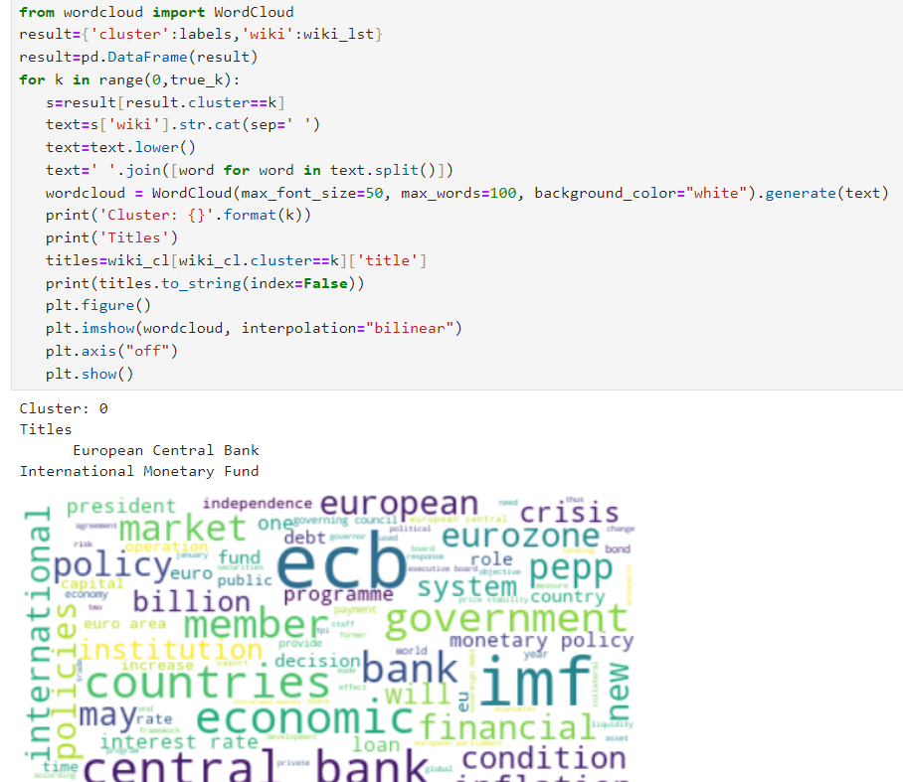
Module 1
Document clustered using python,with own dataset

Slide 8
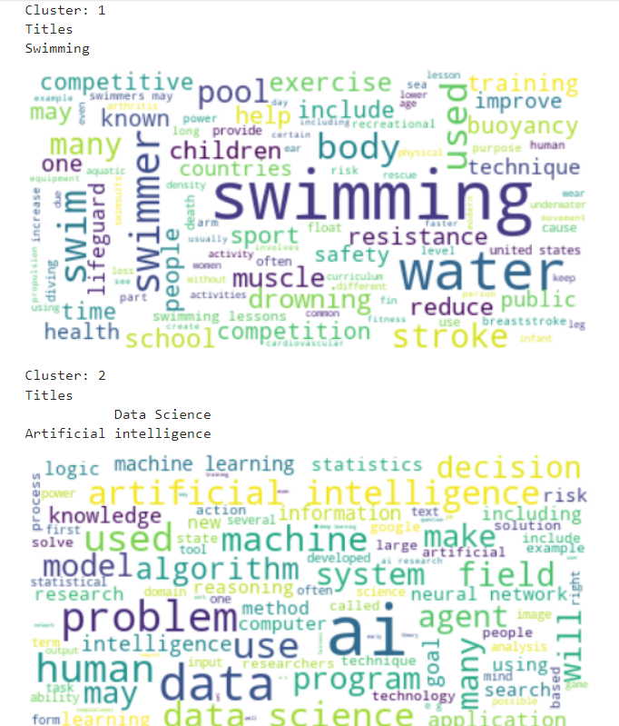
Module 1 implementation

Slide 9
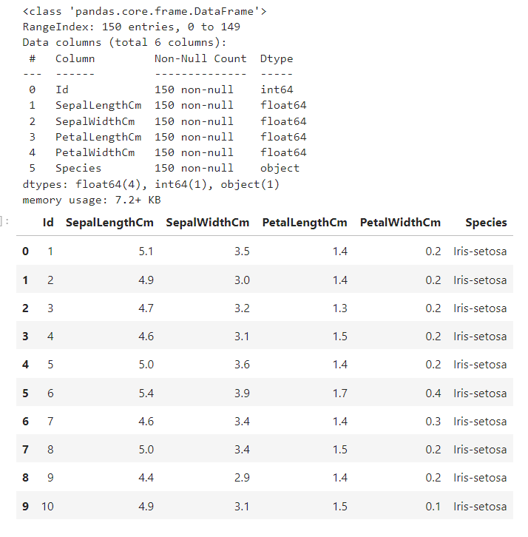
Module 2
In module 2 ,document is clustered for iris dataset.

Slide 10
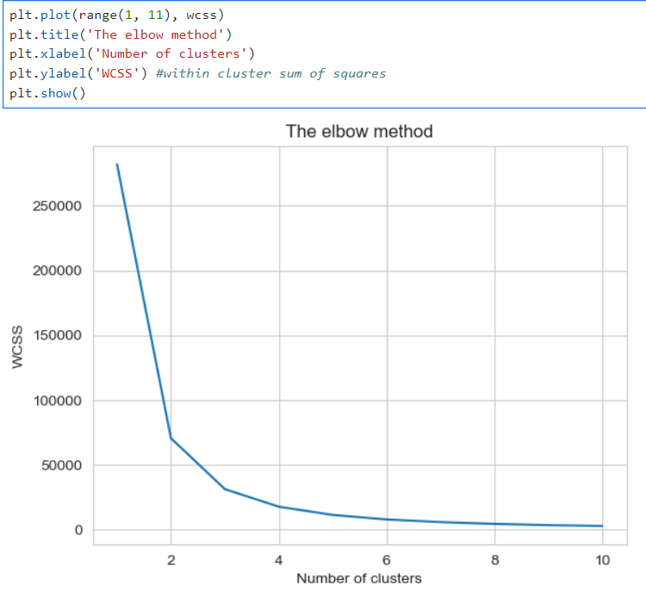
Module 2 Implementation
Elbow method

Slide 11
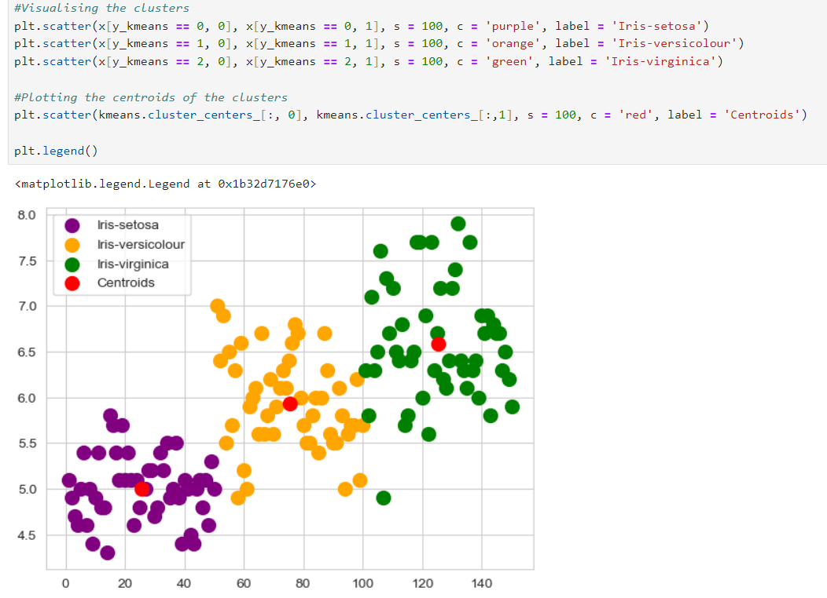
Module 2 Implementation
Clustering document using k-means algorithm.

Slide 12
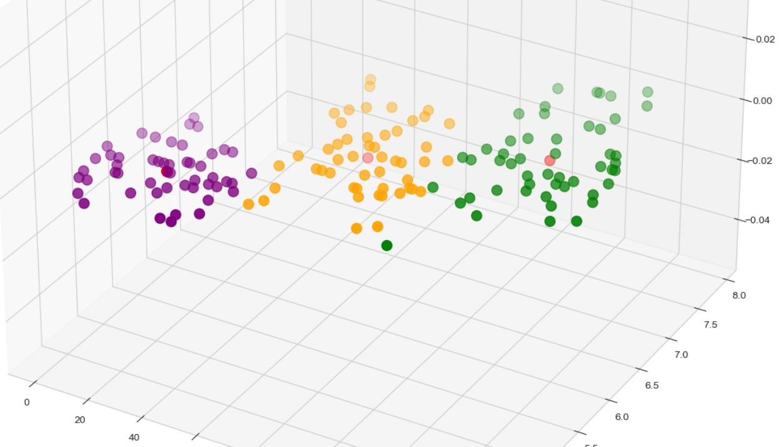
Module 2 Implementation
3-D VIZUALIZATION

Slide 13
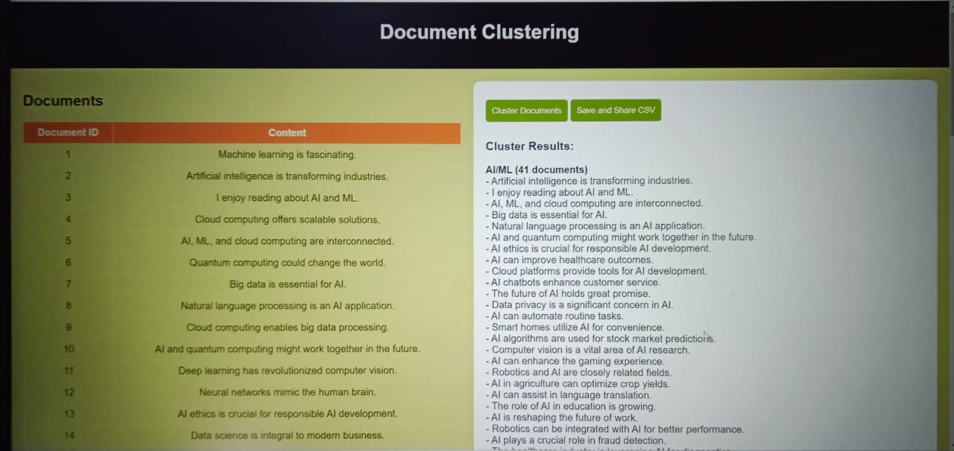
Module 3
Website is created using html,css and java

Slide 14
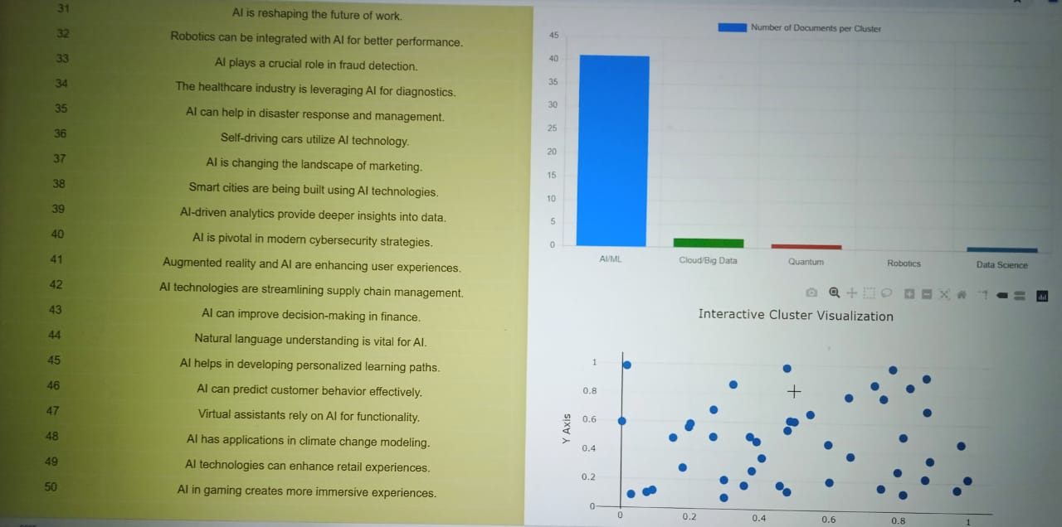
Module 3 Implementation
Vizualization

Slide 15
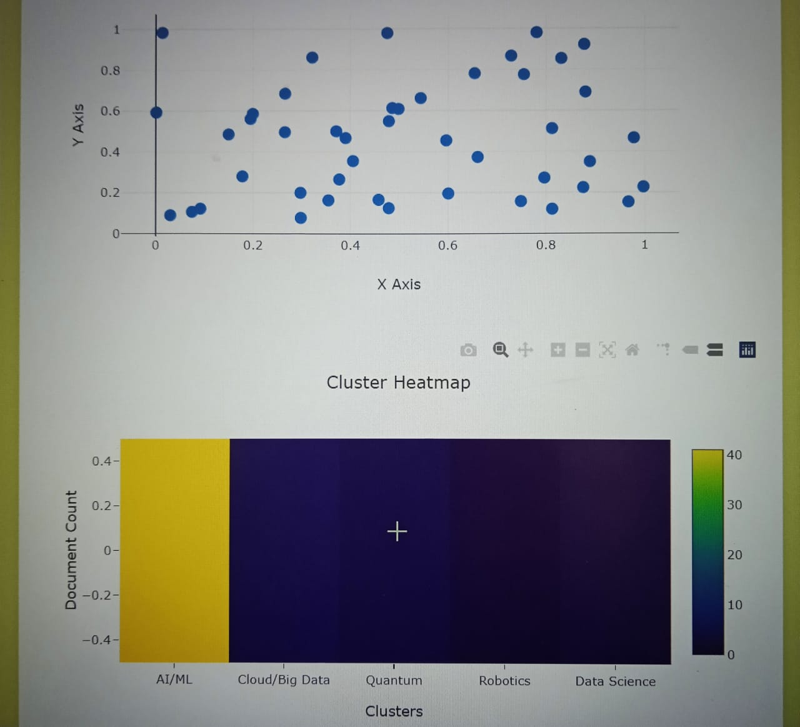
Module 3
Heatmap

Slide 16
Conclusion
Document clustering is a powerful technique for organizing and uncovering patterns in unstructured textual data. By leveraging clustering algorithms, we can group similar documents together based on their content, making information retrieval and topic discovery more efficient. The choice of algorithm depends on the nature of the dataset, the shape of the clusters, and specific use cases:
K-Means is ideal for simple, well-separated clusters.
Hierarchical Clustering is beneficial when hierarchical relationships or dendrogram visualizations are required.
DBSCAN excels in handling noise and irregular clusters.
Latent Dirichlet Allocation (LDA) is optimal for discovering underlying topics within documents.
Spectral Clustering and Affinity Propagation are useful for complex, non-linear clusters.

Slide 17
Reference
clustering document with python
document clustering using iris dataset
file:///C:/Users/boopa/Downloads/document%20clustering/templates/index.html

